Slide 1

INTRODUCTION TO SUSTAINABILITY
LESSON 2
This Photo by Unknown author is licensed under CC BY-ND.

Slide 2
SUSTAINABILITY RELATED ISSUES
A number of serious issues taking place across the world has resulted in Sustainability being a major point of discussion that requires the attention of individuals, corporates and entire countries alike. While the sustainability related issues is expansive this lesson focuses on some of its most crucial areas that has forced world leaders to look at sustainable development in a serious manner. These issues include:
1. Rise of world population
2. Rapid urbanization
3. Resource depletion
4. Greenhouse effect and climate change
5. Loss of biodiversity
6. Inequality at a global level

Slide 3
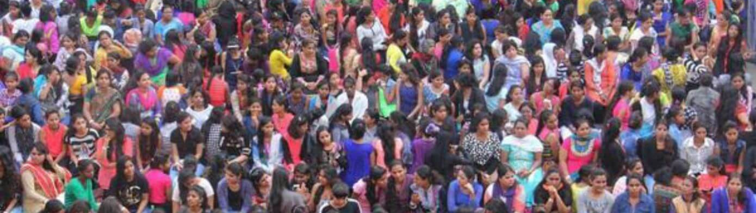
RISING WORLD POPULATION
Rapid population growth can undermine economic development and countries with higher population growth rates are typically also poorer, have higher carbon footprints per capita and experience slower growths in income per capita.
In 2017 (UN DESA 2015a), the total world population was 7.55 billion. There will be 8.55 billion people by 2030, and almost 10 billion by 2050 (9.77 billion).
This Photo by Unknown author is licensed under CC BY.
Notes:
https://www.wwf.org.au/get-involved/change-the-way-you-live/ecological-footprint-calculator#gs.bcf7lt – Ecological Footprint

Slide 4
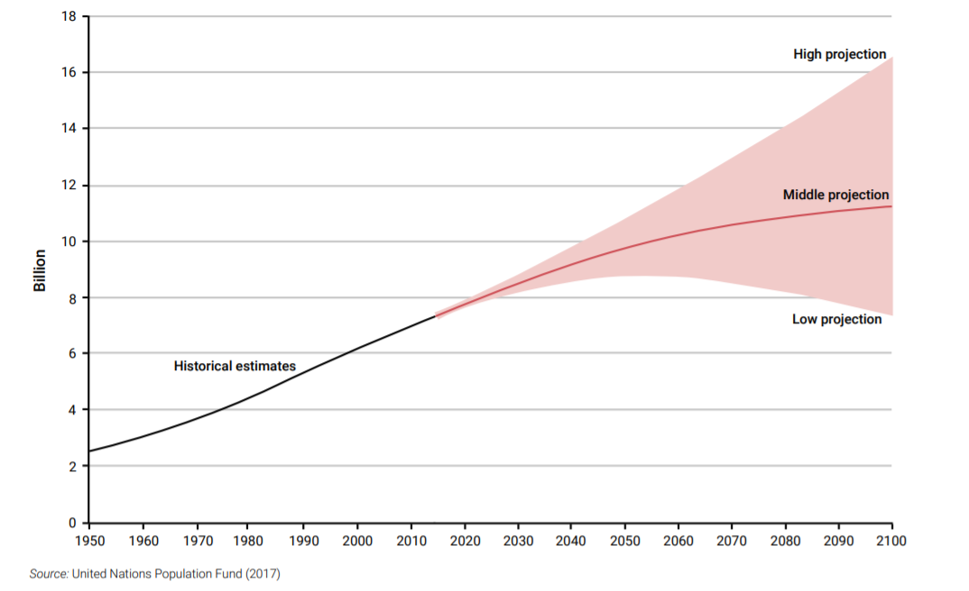
Notes:
https://www.footprintnetwork.org/our-work/ecological-footprint/

Slide 5
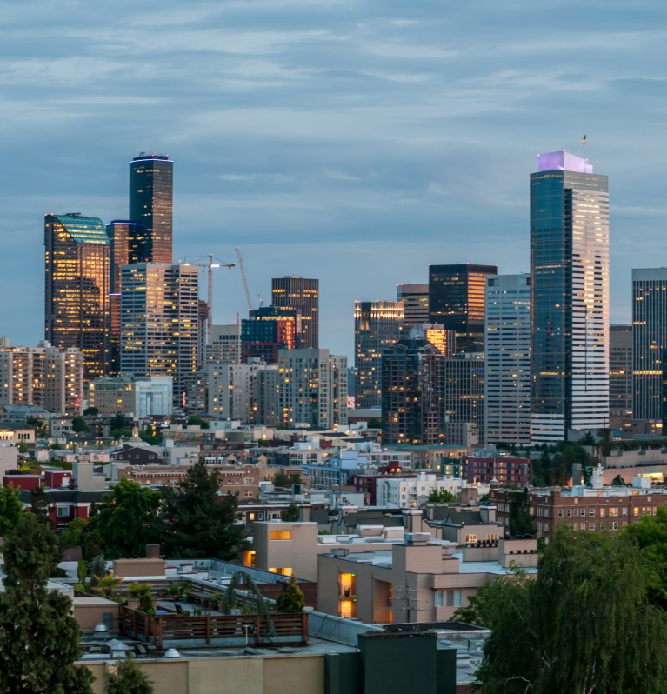
RAPID URBANIZATION
Slightly more than half of the world’s population is currently living in urban areas, a share that is expected to rise to 60 per cent by 2030 and 66.4 per cent by 2050.
Urban areas have higher incomes and consumption, greater access to political power, higher rates of economic growth, and, per capita and also, place a higher pressure on natural resources.
Urbanization also carry a number of other issues such pollution, congestion, urban heat effect, ill health, crime, informal settlements (slums), lack of affordability and waste.

Slide 6
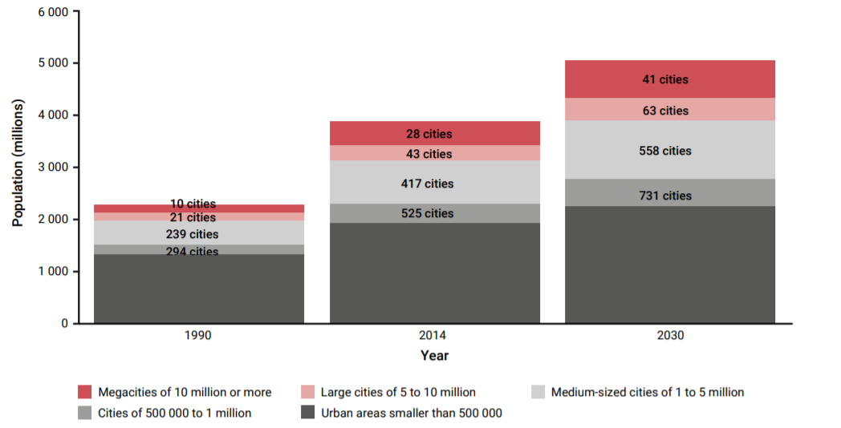

Slide 7
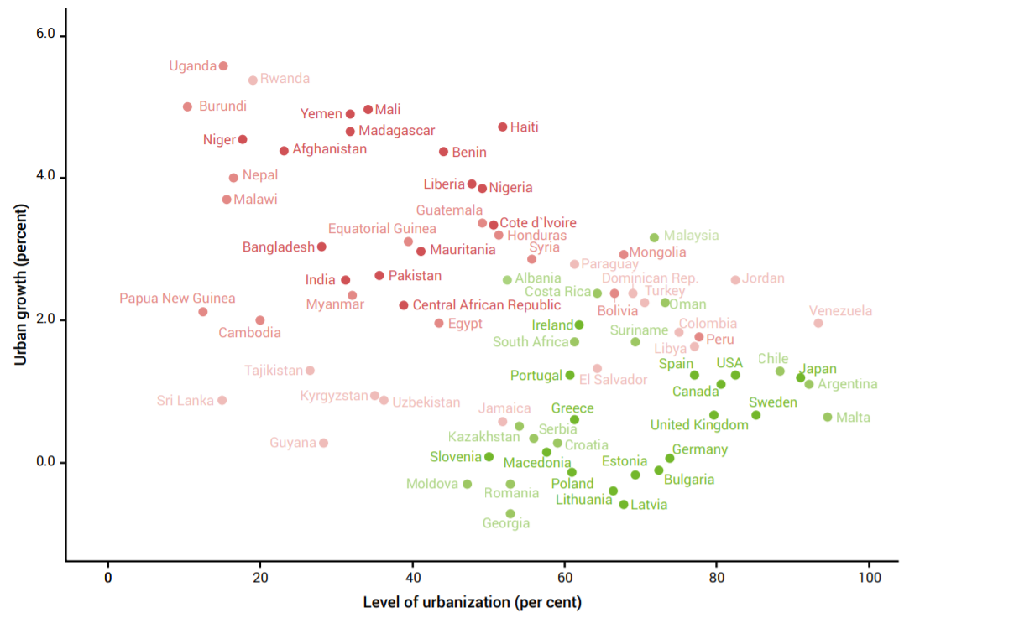

Slide 8
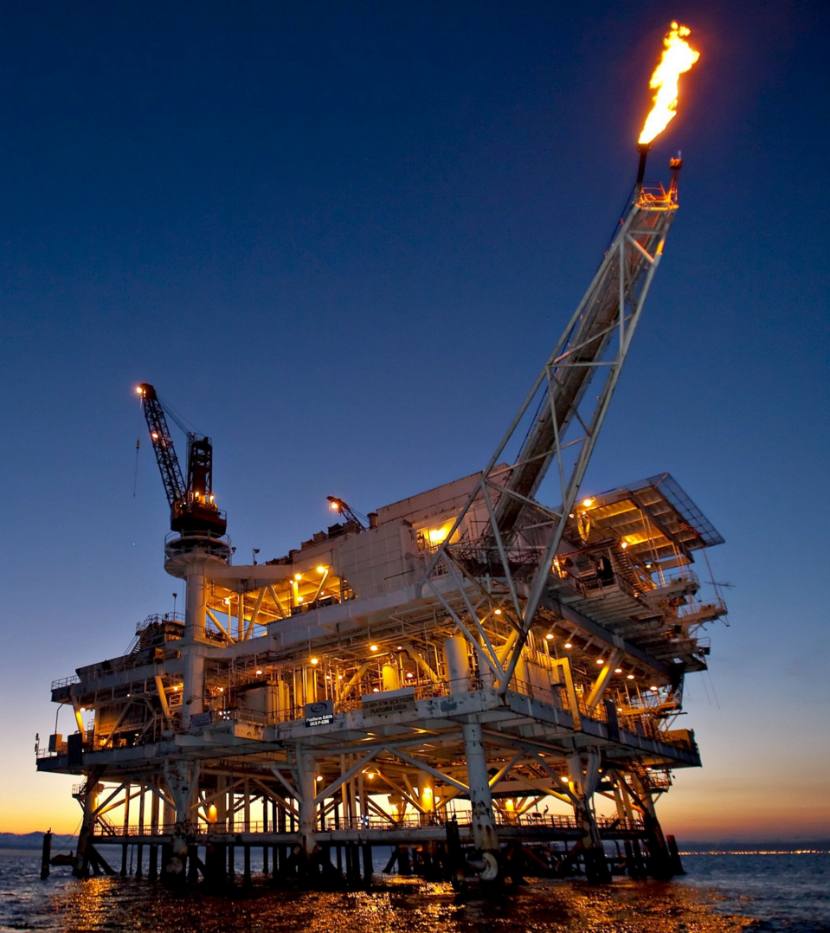
RESOURCE DEPLETION
From the 20th century, resource exploitation has grown considerably, especially of metals (iron and copper), and of minerals (sand and limestone) for cement. Fossil fuel exploitation has also created great challenges due to its ever-increasing consumption.
By 2015, global energy consumption reached around 13.5 billion tons of oil equivalent and is expected to increase to around 19 billion tons by 2040
The rise in water demand has also resulted in global usable water reserves to decline.
This Photo by Unknown author is licensed under CC BY-SA.

Slide 9
DEPLETING RESOURCES
Renewable resources (water, soil, fish, forests) - Usage of the resource cannot exceed the rate of regeneration of the resource.
Non-renewable resources (Fossil groundwater, fossil fuels, and high-grade minerals) - The rate of use can be no greater than the rate at which renewable resources can be substituted for these nonrenewable resources

Slide 10
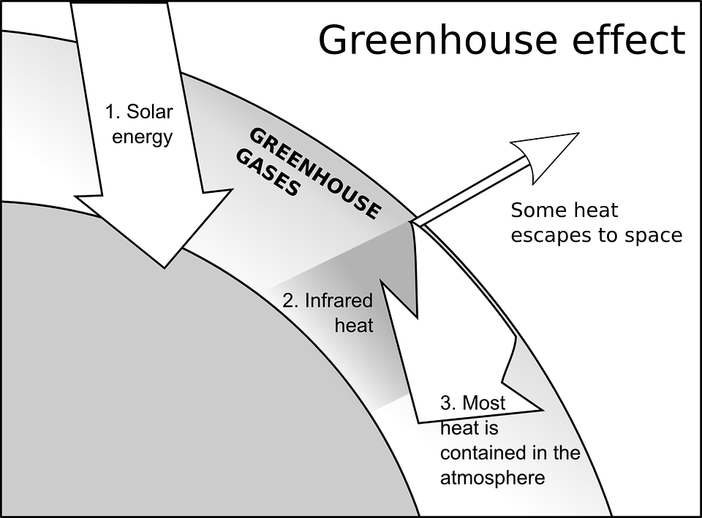
GREENHOUSE EFFECT
The greenhouse effect is a foremost factor in keeping the Earth habitable because it keeps some of the planet's heat that would otherwise escape from the atmosphere out to space. In fact, without the greenhouse effect the Earth's average global temperature would be much colder and life on Earth as we recognize it would not be possible
The prime forcing gases of the greenhouse effect are carbon dioxide (CO2), methane (CH4), nitrous oxide (N2O), and fluorinated gases.
GHG emissions are caused due to extended energy consumption, increasing emission from landfills, livestock, rice farming, septic processes, increased industrialisation, use of fertilizers, burning of fossil fuels and other human and natural activities

Slide 11

GLOBAL GREEN HOUSE GAS EMISSIONS OUTLOOK
Global GHG emissions continued to grow for the third consecutive year in 2019, reaching a record high of 52.4 GtCO2e.
CO2 emissions could decrease by about 7 per cent in 2020 compared with 2019 emission levels due to COVID-19. Studies indicate that the biggest changes have occurred in transport.
The COVID-19 crisis offers only a short-term reduction in global emissions and will not contribute significantly to emissions reductions
Over the last decade, the top Seven emitters (China, the United States of America, EU27+UK, India, Russia, Japan and International transport) have contributed to 65 per cent of the total GHG emissions!

Slide 12
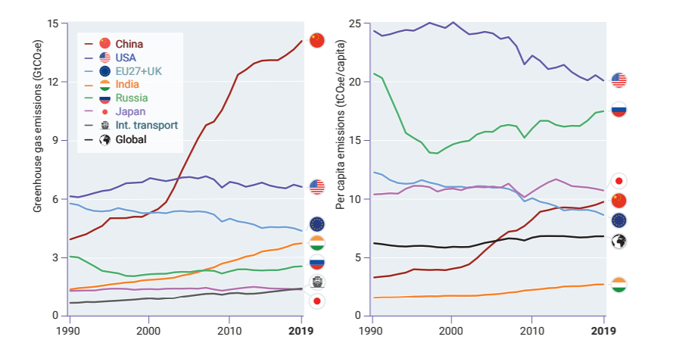

Slide 13
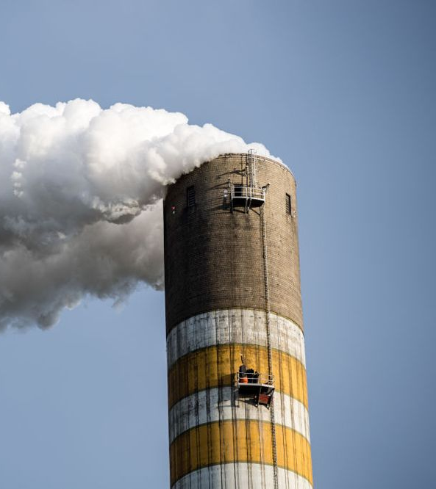
CLIMATE CHANGE
Climate change is driven by modifications in atmospheric composition caused through greenhouse gas (GHG) emissions.
Eight of the ten warmest years on record have occurred within the past decade.
The current GHG emission rate, if it persists, will result in continuation of the current rate of global temperature increase of ~0.2°C per decade.
This Photo by Unknown author is licensed under CC BY.

Slide 14
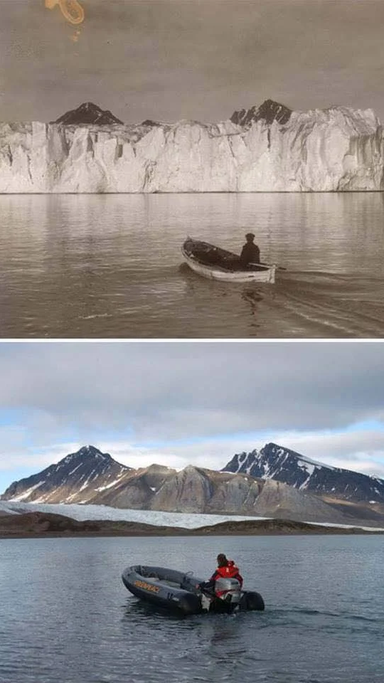
IMPACTS OF CLIMATE CHANGE
Climate change will amplify existing risks and create new risks for natural and human systems. The risks are not only unevenly distributed but are generally greater for disadvantaged people and communities.
Beyond temperature increase, the impacts already observed include changes in the water cycle, warming of the oceans, shrinking of the Arctic ice cover, increase in the global mean sea level, and altering of the carbon and biogeochemical cycles.
Time is running out to prevent the irreversible and dangerous impacts of climate change. These effects include extreme events (including flooding, hurricanes and cyclones) leading to loss of lives and livelihoods, pervasive droughts leading to loss of agricultural productivity and food insecurity, severe heat waves, changes in disease mortality rates, slowdowns in economic growth, and increased potentials for violent conflict.

Slide 15
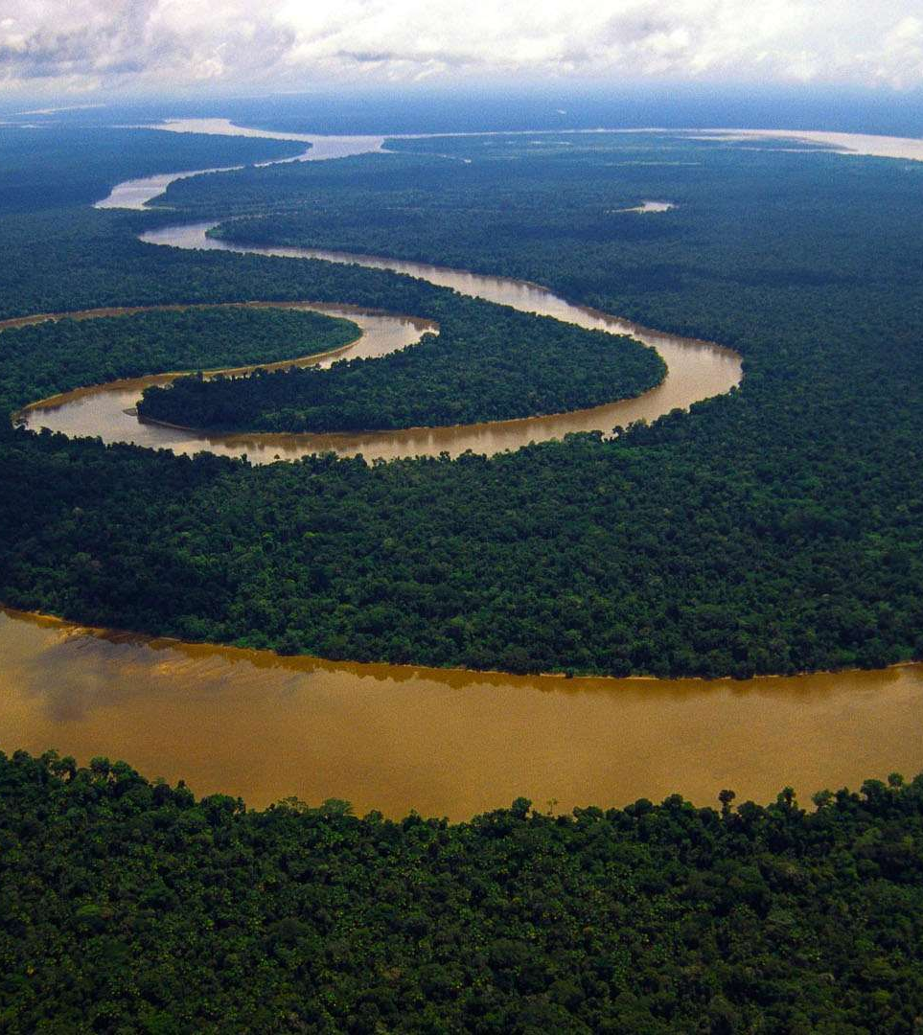
LOSS OF BIODIVERSITY
Biodiversity helps regulate climate through carbon storage and control of local rainfall, filters air and water, and mitigates the impact of natural disasters such as landslides and coastal storms. Direct benefits include timber from forests, fish from oceans and freshwater systems, crops and medicines from plants, cultural identity, and the health benefits gained from access to nature.
Biodiversity contributes positively to human health and well-being. The livelihoods of more than 70 per cent of the world’s population living in poverty depend on natural resources to some extent

Slide 16
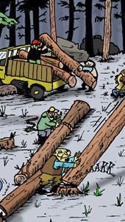
LOSS OF BIODIVERSITY
Global biodiversity is in crisis. There is well-established evidence indicating an irrevocable and continuing decline of genetic and species diversity, and degradation of ecosystems at local and global scales.
Biodiversity is being eroded by land-use change, direct exploitation, climate change, pollution and invasive alien species. While habitat loss and transformation is likely the most significant present pressure
Energy production, resource extraction, wildlife trade and poaching, chemical waste and plastics in the marine environment are also contributing to biodiversity decline.
This Photo by Unknown author is licensed under CC BY-NC-ND.

Slide 17
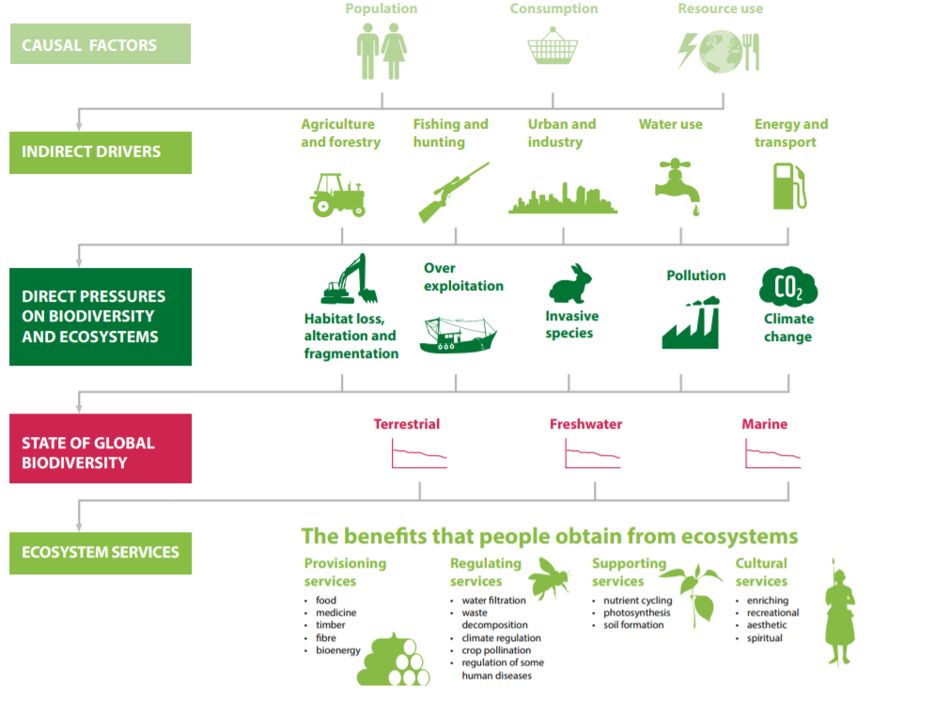

Slide 18
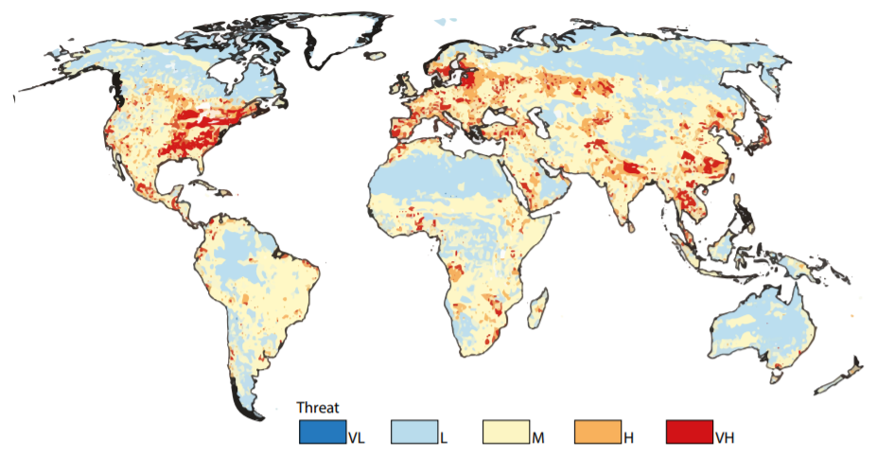

Slide 19
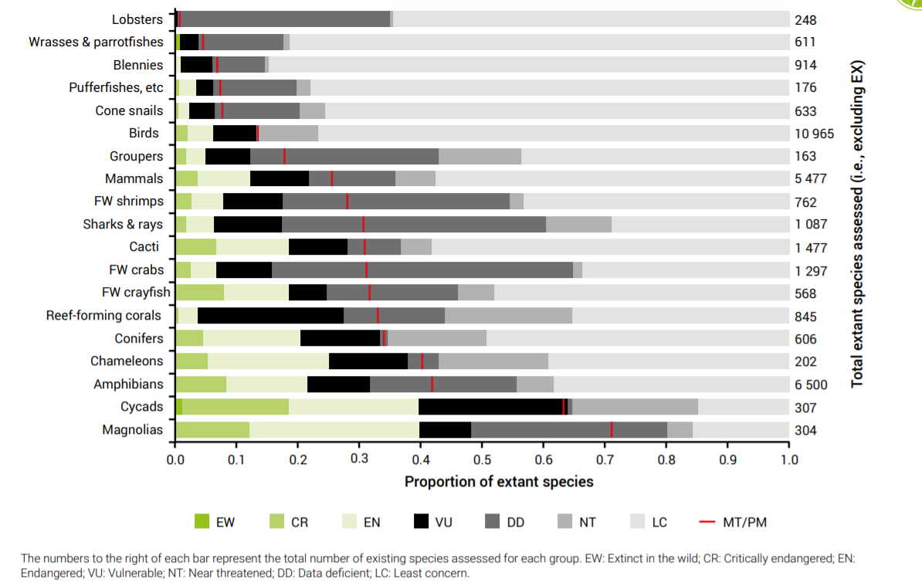

Slide 20

GLOBAL INEQUALITY
Global inequality remains significantly high despite of rapid progressions across the world for universal equality.
The world is far from the goal of equal opportunity for all: circumstances beyond an individual’s control, such as gender, race, ethnicity, migrant status and, for children, the socioeconomic status of their parents, continue to affect one’s chances of succeeding in life.
Rising inequality has created discontent, deepened political divides and has resulted in creating violent conflicts as well.
This Photo by Unknown author is licensed under CC BY-NC-ND.

Slide 21
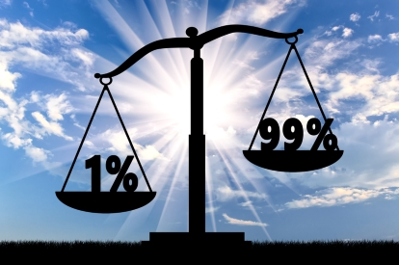
ECONOMIC INEQUALITY
People’s opportunities in life and the future of their children are largely shaped by their income and wealth.
In relative terms, income inequality among countries is declining. However, the average income of people living in the European Union is 11 times higher than that of people in sub-Saharan Africa; the income of people in Northern America is 16 times higher than that of sub-Saharan Africans.
While inequalities between average national incomes are large, considerable disparities are also found among people at the bottom and at the top of the income distribution across and within countries
This Photo by Unknown author is licensed under CC BY.

Slide 22
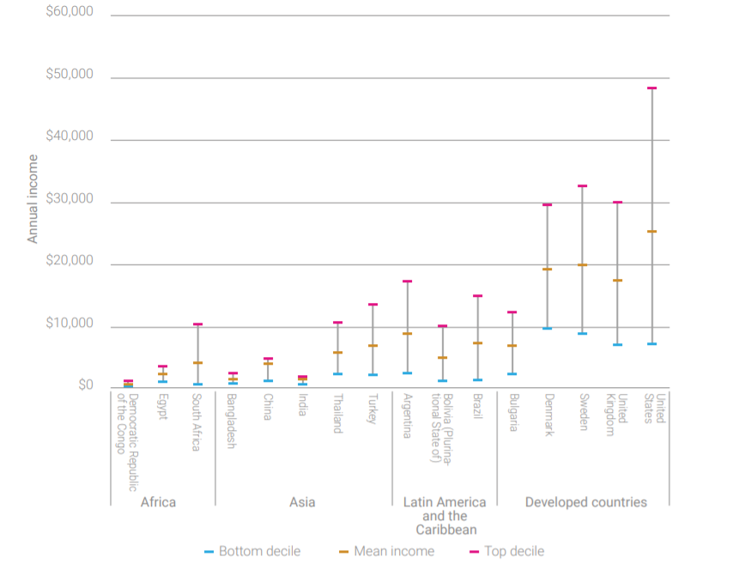

Slide 23
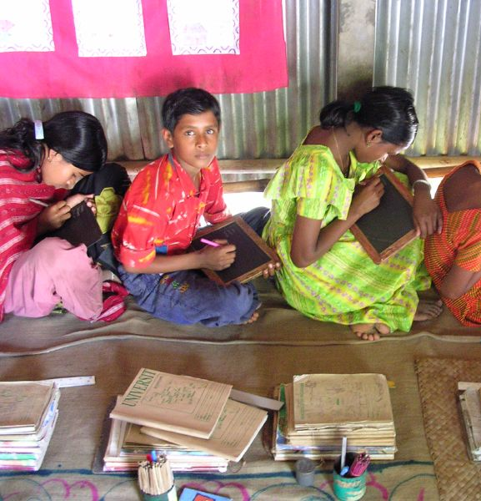
OPPORTUNITY INEQUALITY
The world is far from giving all people and groups the same opportunity to live a healthy and prosperous life.
This is critical in the case of young children, who bear little responsibility for the opportunities afforded to them, but whose early life experiences have a major influence on their health, well-being and even productivity throughout their lifetimes.
Opportunity inequality lies in a number of different areas but predominantly in poverty, health, education and employment.
This Photo by Unknown author is licensed under CC BY-SA.

